Slide 1

Physics 221:
General Physics II
Electricity, Magnetism, Optics and Modern Physics
Lecture 12:
Applications
Magnetic induction
Lentz’s Law
Faraday’s Law
Reading: 21.1-21.4
Notes:
Demos:
6D-04 Earth Magnetic Field Inductor (https://www.physics.purdue.edu/demos/display_page.php?item=6D-04)
Drop magnet through pipe: 6D-09 Lenz's Law (https://www.physics.purdue.edu/demos/display_page.php?item=6D-09)
6D-08 Magnetic Braking (https://www.physics.purdue.edu/demos/display_page.php?item=6D-08)
6B-20 St. Louis Motor (https://www.physics.purdue.edu/demos/display_page.php?item=6B-20)

Slide 2




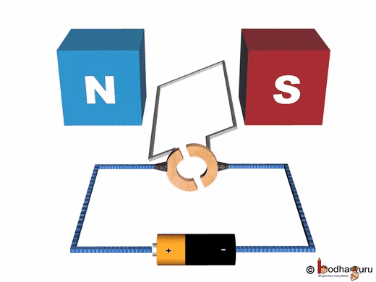
Current loop in magnetic field
D
Current flows through a loop as shown, loop’s plane is perpendicular to B-field.
Q: What is the direction of magnetic force on side A?
I
I
Q: What is the direction of magnetic force on side B?
A
B
There will be torque on the loop!
+ -
Right
Left
Into the page
Out of the page
DC electric motor!
Transforms electric energy into mechanical energy.
Notes:
1: out
6B-15

Slide 3


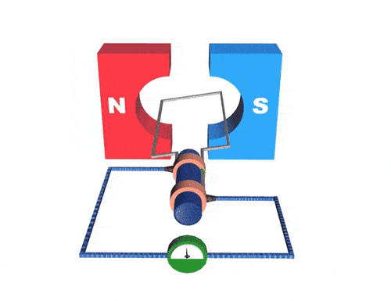
Conducting loop in magnetic field
D
Loop rotates around its axis in magnetic field
Out of page
Into page
Q: What is the direction of force on positive charges in side A?
Right
Left
Down
Up
Q: What is the direction of force on positive charges in side B?
A
B
+ -
Electric generator!
Transforms mechanical energy
into electric energy.
Alternative way to describe it: induction
Notes:
1: out
6B-16

Slide 4
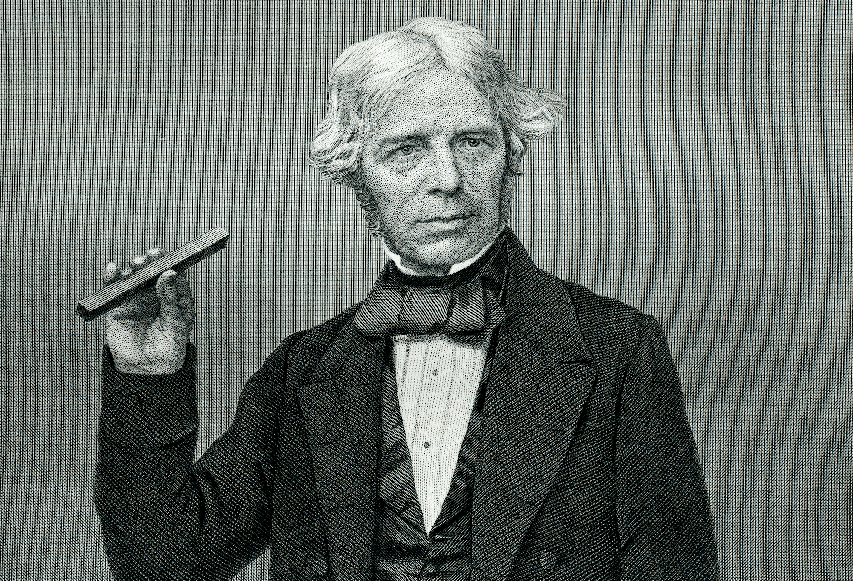
Magnetic Induction
In 1831, Faraday discovered that a changing magnetic field creates an electric field:
  This phenomenon of inducing an electric current using a changing magnetic field is called magnetic induction.
  It can be used to induce a current in a closed loop of wire without using a battery.
  Faraday’s discovery relates electricity and magnetism in a fundamental way.
Michael Faraday
How large is the induced field/current; and in which direction?

Slide 5
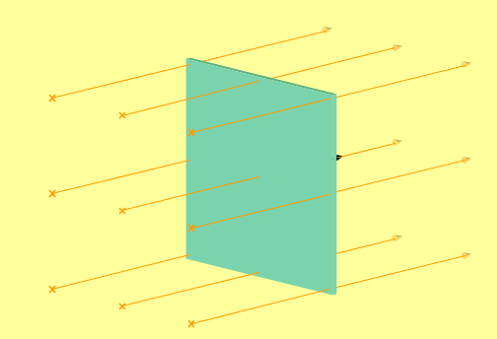
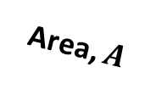
Magnetic Flux
Magnetic flux is the “number” of magnetic field lines intersecting a surface:
Strength of magnetic field = magnetic flux density
Area, $A$
Analogy: water flux through some area, depends on area and velocity of water.

Slide 6
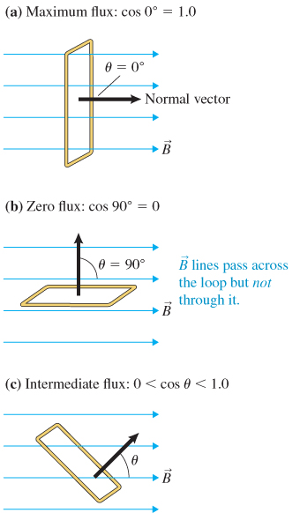
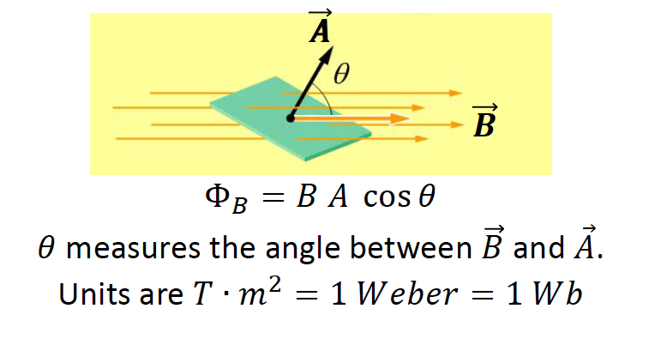
Magnetic Flux
More generally, magnetic flux through a region:

Slide 7
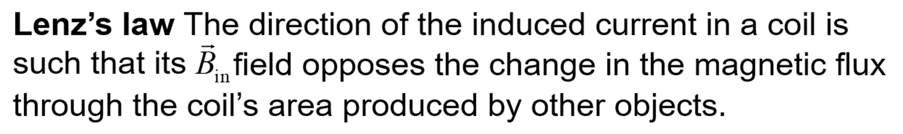
Direction of the Induced Current
Change in magnetic flux induces an e.m.f. and therefore a current in a closed loop (made out of metal).
→ Magnetic fields/flux have “inertia” and would prefer to remain constant.

Slide 8
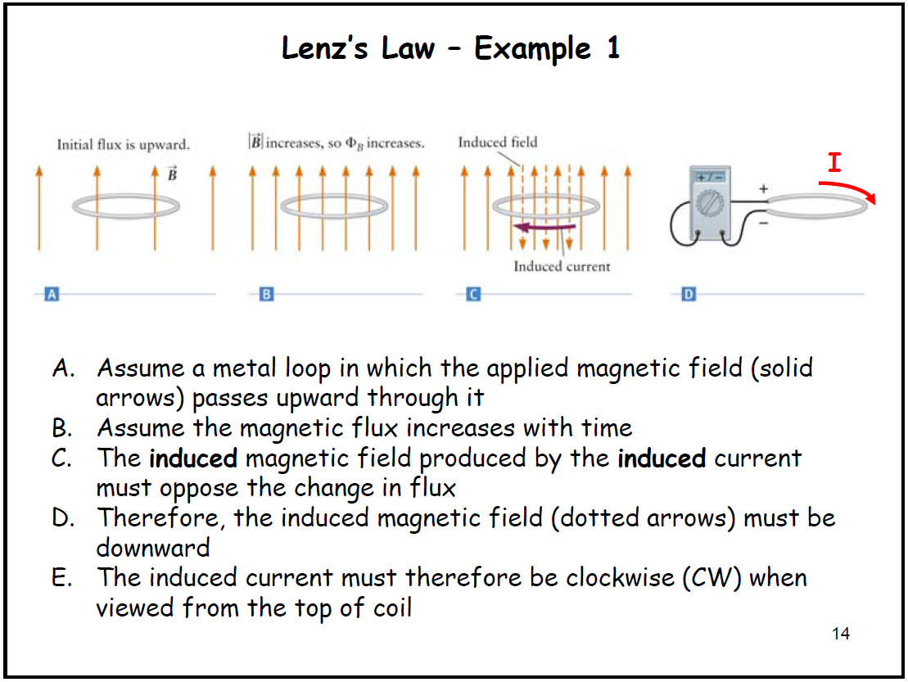

Slide 9
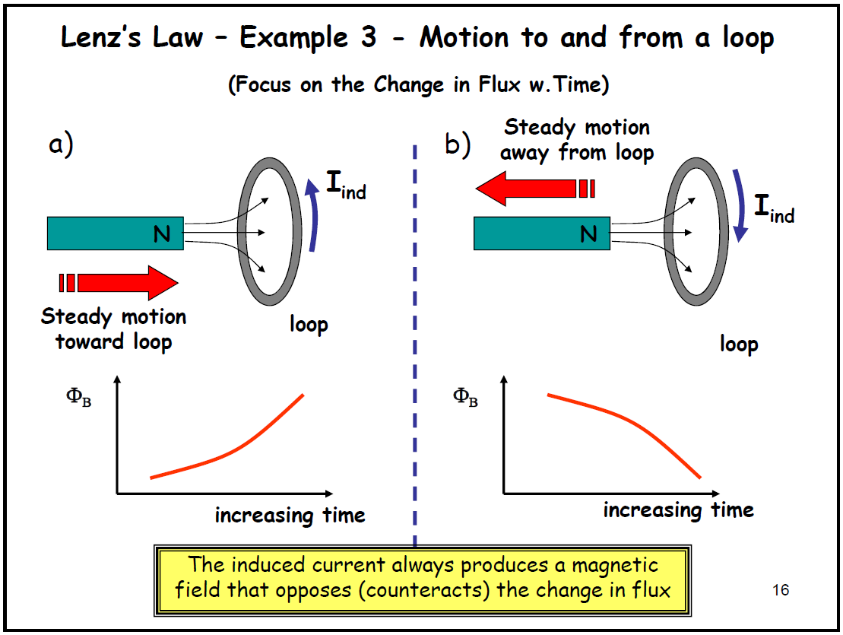
D
Notes:
6D-01

Slide 10
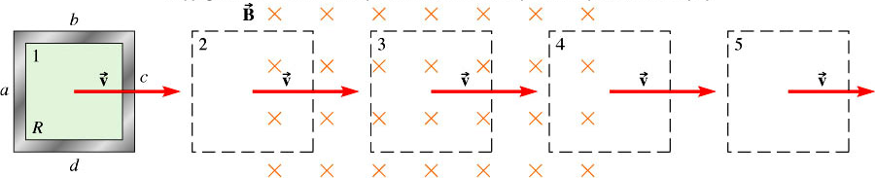
Examples of changing flux
A conductive loop enters and passes the area of uniform magnetic field…
1
2
3
4
5
Q: When a loop is at location 2, what is the direction of current in it?
A. Clockwise B. Counterclockwise C. zero
Q: When a loop is at location 3, what is the direction of current in it?
A. Clockwise B. Counterclockwise C. zero
Q: When a loop is at location 4, what is the direction of current in it?
A. Clockwise B. Counterclockwise C. zero

Slide 11
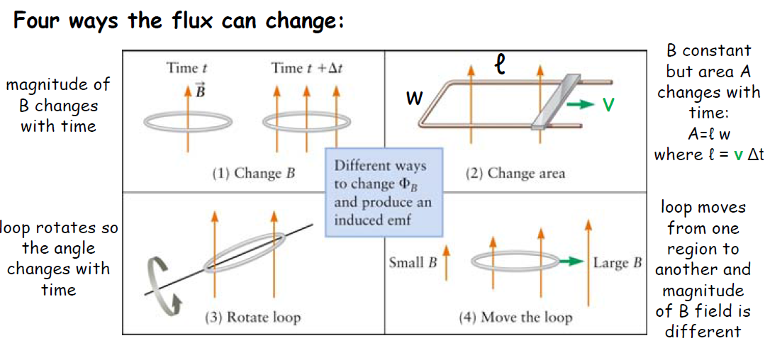
D
Examples of changing flux
Notes:
6D-04

Slide 12
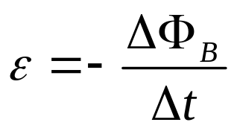
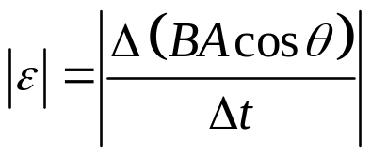
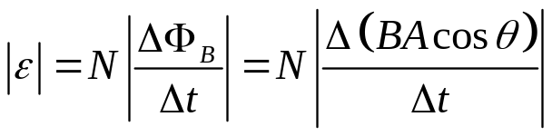
Faraday’s Law
The imduced e.m.f. (ε) created in a closed loop is equal to the rate of change of magnetic field flux through the area of that loop:
(Minus sign indicates Lenz’s law)
Michael Faraday
For a coil with N turns:

Slide 13
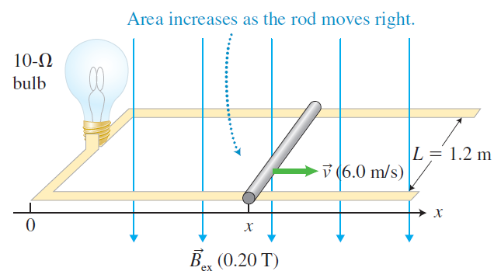
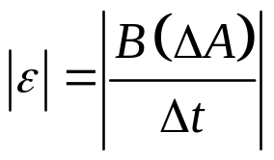
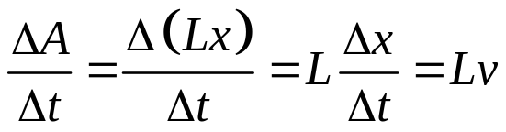
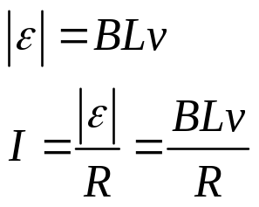
Faraday’s law - Example
Determine the direction of the induced current in the loop, the magnitude of the induced emf, the magnitude of the current in the lightbulb, and the power output of the lightbulb:
0⁰
Only area changes!:
Q: What is the direction of current (seen from above) in it?
A. Clockwise B. Counterclockwise

Slide 14



Demo: E&M Cannon (6D-11)
v
Connect solenoid to a source of alternating voltage.
The flux through the area to axis of solenoid therefore changes in time
A conducting ring placed on top of the solenoid will have a current induced in it opposing this change.
There will then be a force on the ring since it contains a current which is circulating in the presence of a magnetic field.
Note that it’s the off-axis component of B (the “fringe field”) that flings the ring.
B
~
side view
Notes:
DEMO: 6D-11 Jumping Ring – EM Cannon

Slide 15
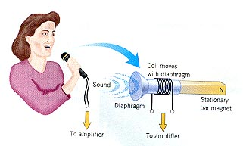
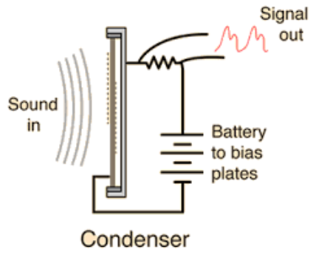
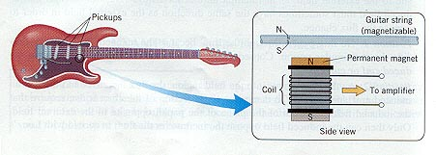
Applications: sound pick-up
Condenser
microphone
Induction
microphone
Change in capacitor: change in capacitance → change in V
Guitar pickup

